Slide 1
Pipelined Implementation

Slide 2
Outline
Handle Control Hazard
Handle Exception
Performance Analysis
Suggested Reading 4.5

Slide 3
Control Hazard

Slide 4
Return Example
demo-retb.ys
0x000: irmovl Stack,%esp # Initialize stack pointer
0x006: call p # Procedure call
0x00b: irmovl $5,%esi # Return point
0x011: halt
0x020: .pos 0x20
0x020: p: irmovl $-1,%edi # procedure
0x026: ret
0x027: irmovl $1,%eax # Should not be executed
0x02d: irmovl $2,%ecx # Should not be executed
0x033: irmovl $3,%edx # Should not be executed
0x039: irmovl $4,%ebx # Should not be executed
0x100: .pos 0x100
0x100: Stack: # Stack: Stack pointer
  Previously executed three additional instructions
Notes:
在ret知道正确的返回地址之前，流水线中已经有三条错误的指令被读入了。（因为ret知道返回地址是在memory stage，这时在fetch, decode, execute stage各有一条指令在执行）

Slide 5
Correct Return Example
#demo_retb
0x026: ret
bubble
bubble
bubble
0x00b: irmovl $5, %esi #return
As ret passes through pipeline, stall at fetch stage
  While in decode, execute, and memory stage
  fetch the same instruction after ret 3 times.
Inject bubble into decode stage
Release stall when reach write-back stage
F
D
E
M
W
F
D
E
M
W
F
D
E
M
W
F
D
E
M
W
F
F
D
D
E
E
M
M
W
W
W
W
valM
valM
=
=
0x0b
0x0b
•
•
•
F
F

valC

valC
5
5

rB

rB
%
%
esi
esi

Slide 6
Detecting Return
M
icode
Cnd
valE
valA
dstE
dstM
e_Cnd
ALU
ALU
CC
ALU
CC
fun.
ALU
ALU
Execute
A
B
E
icode
ifun
valC
valA
valB
dstE
dstM
srcA
srcB
d_
srcA
d_
srcB
dstE
dstM
srcA
srcB
Sel
Fwd
+Fwd
A
B
Decode
A
M
B
Register
Register
file
file
E
D
icode
ifun
rA
rB
valC
valP
Notes:
因为原来valA是通过选择Select valP和srcA对应的值来的。现在srcA对应的值通过forward模块进行选择到底从那里得到。所以valA必须经过select和forward两个模块。所以简写为
Sel+Fwd A.

Slide 7
Control for Return
Condition | Trigger
Processing ret | IRET in { D_icode, E_icode, M_icode }
# demo-retb
0x026: ret
F
D
E
M
W
bubble
F
D
E
M
W
bubble
F
D
E
M
W
bubble
F
D
E
M
W
F
F
D
D
E
E
M
M
W
0x00b:
irmovl
$5,%
esi
# Return
W
Condition | F | D | E | M | W
Processing ret | stall | bubble | normal | normal | normal
Notes:
通过让fetch stall,就使得fetch总是在fetch ret之后的一条指令，但因为向D中插入bubble，所以这条指令也不被执行。

Slide 8
W
icode
valE
valM
dstE
dstM
M_
icode
M
icode
Cnd
valE
valA
dstE
dstM
E_
icode
Pipe
E
icode
ifun
valC
valA
valB
dstE
dstM
srcA
control
srcB
logic
D_
icode
D_bubble
D
icode
ifun
rA
rB
valC
valP
F_stall
F
predPC

Slide 9
Special Control Cases
Detection
Condition | Trigger
Processing ret | IRET in { D_icode, E_icode, M_icode }
Load/Use Hazard | E_icode in { IMRMOVL, IPOPL } && E_dstM in { d_srcA, d_srcB }
Mispredicted Branch | E_icode = IJXX & !e_Cnd
Action
Condition | F | D | E | M | W
Processing ret | stall | bubble | normal | normal | normal
Load/Use Hazard | stall | stall | bubble | normal | normal
Mispredicted Branch | normal | bubble | bubble | normal | normal

Slide 10
W
icode
valE
valM
dstE
dstM
M_
icode
M
icode
Cnd
valE
valA
dstE
dstM
e_Cnd
CC
CC
E_
dstM
E_
icode
Pipe
E_bubble
E
icode
ifun
valC
valA
valB
dstE
dstM
srcA
control
srcB
d_
logic
srcB
d_
srcA
D_
srcB
icode
D_bubble
srcA
D
icode
ifun
rA
rB
valC
valP
D_stall
F_stall
F
predPC

Slide 11
Implementing Pipeline Control
Combinational logic generates pipeline control signals
Action occurs at start of following cycle

Slide 12
Initial Version of Pipeline Control
bool F_stall =
# Conditions for a load/use hazard
E_icode in { IMRMOVL, IPOPL } &&
E_dstM in { d_srcA, d_srcB } ||
# Stalling at fetch
while ret passes through pipeline
IRET in { D_icode, E_icode, M_icode };
bool D_stall =
# Conditions for a load/use hazard
E_icode in { IMRMOVL, IPOPL } &&
E_dstM in { d_srcA, d_srcB };

Slide 13
Initial Version of Pipeline Control
bool D_bubble =
# Mispredicted branch
(E_icode == IJXX && !e_Cnd) ||
# Stalling at fetch
while ret passes through pipeline
IRET in { D_icode, E_icode, M_icode };
bool E_bubble =
# Mispredicted branch
(E_icode == IJXX && !e_Cnd) ||
# Load/use hazard
E_icode in { IMRMOVL, IPOPL } &&
E_dstM in { d_srcA, d_srcB};

Slide 14
Control Combinations
1
1
1
2
2
2
3
3
Load/use
Mispredict
3
Mispredict
ret
ret
ret
ret
ret
ret
ret
ret
ret
ret
ret
M
M
ret
M
M
M
M
M
M
M
M
M
M
Load
bubble
bubble
JXX
bubble
JXX
ret
ret
E
E
ret
E
E
E
E
E
E
E
E
E
E
Use
bubble
bubble
bubble
bubble
bubble
ret
bubble
ret
D
D
ret
D
D
D
D
D
D
D
D
D
D
Combination A
Combination B
  Special cases that can arise on same clock cycle
Combination A
  Not-taken branch
  ret instruction at branch target
Combination B
  Instruction that reads from memory to %esp
  Followed by ret instruction
Notes:
对于ret2，当decode一条ret时，自动会在D中插入bubble,这样当下一cycle时，decode stage中只可能是bubble.

Slide 15
Control Combination A
PC
Instruction
PC
PC
1
memory
increment
1
Mispredict
1
Mispredict
ret
ret
ret
memory
M
M
f_PC
M
M
M
Fetch
M_
valA
JXX
Select
E
JXX
E
E
E
E
PC
W_
ret
valM
ret
D
ret
D
D
D
D
Combination A
F
predPC
Condition | F | D | E | M | W
Processing ret | stall | bubble | normal | normal | normal
Mispredicted Branch | normal | bubble | bubble | normal | normal
Combination | stall | bubble | bubble | normal | normal

Slide 16
Control Combination A
Condition | F | D | E | M | W
Processing ret | stall | bubble | normal | normal | normal
Mispredicted Branch | normal | bubble | bubble | normal | normal
Combination | stall | bubble | bubble | normal | normal
Should handle as mispredicted branch
Stalls F pipeline register
But PC selection logic will be using M_valA anyhow

Slide 17
Control Combination B
Load/use
ret
M
M
M
M
E
Load
E
E
E
Use
ret
ret
D
D
ret
D
D
Combination B
Condition | F | D | E | M | W
Processing ret | stall | bubble | normal | normal | normal
Load/Use Hazard | stall | stall | bubble | normal | normal
Combination | stall | bubble + stall | bubble | normal | normal
Would attempt to bubble and stall pipeline register D
Signaled by processor as pipeline error
Notes:
Ret在D中插入bubble的前提是他自己往前走，而让decode空操作。但现在因为load/use要求ret不能往前走(stall)，这样也就不需要在D中插入bubble.

Slide 18
Handling Control Combination B
Condition | F | D | E | M | W
Processing ret | stall | bubble | normal | normal | normal
Load/Use Hazard | stall | stall | bubble | normal | normal
Combination | stall | stall | bubble | normal | normal
Load/use hazard should get priority
ret instruction should be held in decode stage for additional cycle

Slide 19
Corrected Pipeline Control Logic
bool D_bubble =
# Mispredicted branch
(E_icode == IJXX && !e_Cnd) ||
# Stalling at fetch
while ret passes through pipeline
IRET in { D_icode, E_icode, M_icode }
# but not condition for a load/use hazard
&& !(E_icode in { IMRMOVL, IPOPL }
&& E_dstM in { d_srcA, d_srcB });
Condition | F | D | E | M | W
Processing ret | stall | bubble | normal | normal | normal
Load/Use Hazard | stall | stall | bubble | normal | normal
Combination | stall | stall | bubble | normal | normal

Slide 20
Pipeline Summary
Data Hazards
  Most handled by forwarding
    No performance penalty
  Load/use hazard requires one cycle stall
Control Hazards
  Cancel instructions when detect mispredicted branch
    Two clock cycles wasted
  Stall fetch stage while ret passes through pipeline
    Three clock cycles wasted

Slide 21
Pipeline Summary
Control Combinations
  Must analyze carefully
  First version had subtle bug
    Only arises with unusual instruction combination

Slide 22
Exception Handling

Slide 23
Exception
Condition: Instruction encounter an error condition
Deal flow:
  Break the program flow
  Invoke the exception handler provided by OS
  (Maybe) continue the program flow
    E.g. page fault exception
Notes:
很重要的一点就是在exception发生时，引起exception的语句之前的语句已经全部执行完毕，而在exception之后的语句还没有被执行。
Precise exception包括exception之间的相互关系，exception的类型, exception的位置等等。

Slide 24
Exceptions
  Conditions under which pipeline cannot continue normal operation
Causes
  Halt instruction (Current)
  Bad address for instruction or data (Previous)
  Invalid instruction (Previous)
  Pipeline control error (Previous)
Desired Action
  Complete some instructions
    Either current or previous (depends on exception type)
  Discard others
  Call exception handler
    Like an unexpected procedure call
Notes:
完成当前还是前面的指令，主要是说当出现exception时，首先当前指令（引起exception的指令）之前的指令必须已经完成。然后，看语义决定当前指令要不要完成。

Slide 25
Exception Examples
Detect in Fetch Stage
jmp $-1 # Invalid jump target
.byte 0xFF # Invalid instruction code
halt # Halt instruction
Detect in Memory Stage
irmovl $100,%eax
rmmovl %eax,0x10000(%eax) # invalid address

Slide 26
Exceptions in Pipeline Processor #1
# demo-exc1.ys
irmovl $100,%eax
rmmovl %eax,0x10000(%eax) # Invalid address
nop
.byte 0xFF # Invalid instruction code
Exception detected
1
2
3
4
5
0x000: irmovl $100,%eax
F
D
E
M
W
0x006: rmmovl %eax,0x10000(%eax)
F
D
E
M
0x00c: nop
F
D
E
0x00d: .byte 0xFF
F
D
Exception detected
Desired Behavior
  rmmovl should cause exception
Notes:
假定我们不允许访问地址超过0x10000以上的内存。
上图中出现了两个exception. 显然我们希望在比较后面阶段的那条指令（也就是先执行的那条指令）触发的exception

Slide 27
Exceptions in Pipeline Processor #2
# demo-exc2.ys
0x000: xorl %eax,%eax # Set condition codes
0x002: jne t # Not taken
0x007: irmovl $1,%eax
0x00d: irmovl $2,%edx
0x013: halt
0x014: t: .byte 0xFF # Target
1
2
3
4
5
6
7
8
9
0x000: xorl %eax,%eax
F
D
E
M
W
0x002: jne t
F
D
E
M
0x014: t: .byte 0xFF
F
D
E
M
W
0x???: (I’m lost!)
F
D
E
M
W
0x007: irmovl $1,%eax
F
D
E
M
W
Desired Behavior
  No exception should occur
Exception detected
Notes:
因为misprediction造成的branch错误，使得本来不该执行的指令执行了。这也可能引发exception。对于这种情况，我们需要考虑如何恢复到正常状态，而不是报错。

Slide 28
Maintaining Exception Ordering
W
stat
icode
valE
valM
dstE
dstM
M
stat
icode
Cnd
valE
valA
dstE
dstM
E
stat
icode
ifun
valC
valA
valB
dstE
dstM
srcA
srcB
D
stat
icode
ifun
rA
rB
valC
valP
F
predPC
Add exception status field to pipeline registers
Fetch stage sets to either “AOK”, “ADR” (when bad fetch address), or “INS” (illegal instruction)
Decode & execute pass values through
Memory either passes through or sets to “ADR”
Exception triggered only when instruction hits write back
Notes:
AOK表示合法的指令。其他两种表示错误的指令。
只在Write back阶段才去处理exception，因为指令是顺序流出的，这样exception的先后顺序就保证了，并且前面没有发生exception的指令才会得以执行完。
当某些指令先fetch了，后来又取消了（比如misprediction），那么我们只要简单的将其取消就可以了（连同保存的exception状态）。因为它无法到达Write back阶段，所以也就不会爆出exception.

Slide 29
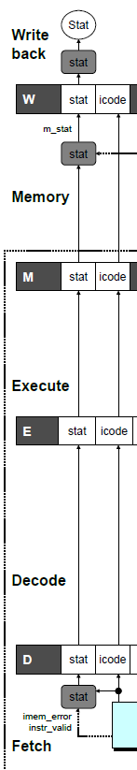
Exception Handling Logic
dmem_error
Fetch Stage
Memory Stage
Writeback Stage
# Determine status code for fetched instruction
int f_stat = [
imem_error: SADR;
!instr_valid : SINS;
f_icode == IHALT : SHLT;
1 : SAOK;
];
# Update the status
int m_stat = [
dmem_error : SADR;
1 : M_stat;
];
int Stat = [
# SBUB in earlier stages indicates bubble
W_stat == SBUB : SAOK;
1 : W_stat;
];

Slide 30
Side Effects in Pipeline Processor
Exception detected
# demo-exc3.ys
irmovl $100,%eax
rmmovl %eax,0x10000(%eax) # invalid address
addl %eax,%eax # Sets condition codes
1
2
3
4
5
0x000: irmovl $100,%eax
F
D
E
M
W
0x006: rmmovl %eax,0x10000(%eax)
F
D
E
M
0x00c: addl %eax,%eax
F
D
E
Desired Behavior
  rmmovl should cause exception
  No following instruction should have any effect
Condition code set
Notes:
前面的exception引发后就不应该执行后面的指令，这样addl指令也就不应该修改状态。
但现在会修改状态的。

Slide 31
Avoiding Side Effects
Presence of Exception Should Disable State Update
  When detect exception in memory stage
    Disable condition code setting in execute
    Must happen in same clock cycle
  When exception passes to write-back stage
    Disable memory write in memory stage
    Disable condition code setting in execute stage
Implementation
  Hardwired into the design of the PIPE simulator
  You have no control over this
Notes:
改变状态有两种：修改CC或者内存。Register的修改要在Write back阶段才修改（所以当有exception时不会发生）。
这样，当前面的指令发生exception时我们要让后面的指令不修改状态。

Slide 32
Control Logic for State Changes
Setting Condition Codes
Stage Control
  Also controls updating of memory
# Should the condition codes be updated?
bool set_cc = E_icode == IOPL &&
# State changes only during normal operation
!m_stat in { SADR, SINS, SHLT }
&& !W_stat in { SADR, SINS, SHLT };
# Start injecting bubbles as soon as exception passes through memory stage
bool M_bubble = m_stat in { SADR, SINS, SHLT }
|| W_stat in { SADR, SINS, SHLT };
# Stall pipeline register W when exception encountered
bool W_stall = W_stat in { SADR, SINS, SHLT };

Slide 33
Rest of Exception Handling
Calling Exception Handler
  Push PC onto stack
    Either PC of faulting instruction or of next instruction
    Usually pass through pipeline along with exception status
  Jump to handler address
    Usually fixed address
    Defined as part of ISA
Implementation
  Haven’t tried it yet!

Slide 34
Processor Summary
Design Technique
  Create uniform framework for all instructions
    Want to share hardware among instructions
  Connect standard logic blocks with bits of control logic
Operation
  State held in memories and clocked registers
  Computation done by combinational logic
  Clocking of registers/memories sufficient to control overall behavior
Enhancing Performance
  Pipelining increases throughput and improves resource utilization
  Must make sure maintains ISA behavior

Slide 35
Performance Analysis

Slide 36
Performance Metrics
Clock rate
  Measured in Megahertz or Gigahertz
  Function of stage partitioning and circuit design
    Keep amount of work per stage small
Rate at which instructions executed
  CPI: cycles per instruction
  On average, how many clock cycles does each instruction require?
  Function of pipeline design and benchmark programs
    E.g., how frequently are branches mispredicted?
Notes:
Stage设计的基本原则：每个stage的工作量尽可能少。Stage的大小尽可能平均。

Slide 37
CPI for PIPE
CPI ≈ 1.0
  Fetch instruction each clock cycle
  Effectively process new instruction almost every cycle
    Although each individual instruction has latency of 5 cycles
CPI > 1.0
  Sometimes must stall or cancel branches
Notes:
我们的设计目标是CPI=1

Slide 38
CPI for PIPE
Computing CPI
  C clock cycles
  I instructions executed to completion
  B bubbles injected (C = I + B)
  CPI = C/I = (I+B)/I = 1.0 + B/I
  Factor B/I represents average penalty due to bubbles
Notes:
我们的设计目标是CPI=1

Slide 39
CPI for PIPE (Cont.)
Typical Values
LP: Penalty due to load/use hazard stalling
  Fraction of instructions that are loads 0.25
  Fraction of load instructions requiring stall 0.20
  Number of bubbles injected each time 1
  ⇒ LP = 0.25 * 0.20 * 1 = 0.05
MP: Penalty due to mispredicted branches
  Fraction of instructions that are cond. jumps 0.20
  Fraction of cond. jumps mispredicted 0.40
  Number of bubbles injected each time 2
  ⇒ MP = 0.20 * 0.40 * 2 = 0.16
Notes:
要减少CPI，关键是MP。因为它占了最大的比重。

Slide 40
CPI for PIPE (Cont.)
Typical Values
RP: Penalty due to ret instructions
  Fraction of instructions that are returns 0.02
  Number of bubbles injected each time 3
  ⇒ RP = 0.02 * 3 = 0.06
Net effect of penalties 0.05 + 0.16 + 0.06 = 0.27
  CPI = 1.27 (Not bad!)
  B/I = LP + MP + RP
Notes:
要减少CPI，关键是MP。因为它占了最大的比重。

Slide 41
Engineering Consideration

Slide 42
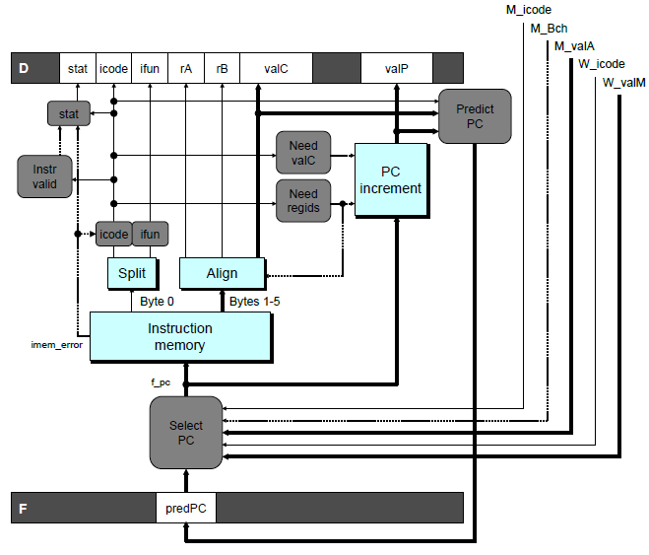
Fetch Logic Revisited
During Fetch Cycle
  Select PC
  Read bytes from instruction memory
  Examine icode to determine instruction length
  Increment PC
Timing
  Steps 2 & 4 require significant amount of time

Slide 43
Standard Fetch Timing
Select PC
need_regids, need_valC
Mem. Read
Increment
1 clock cycle
  Must Perform Everything in Sequence
  Can’t compute incremented PC until know how much to increment it by

Slide 44
A Fast PC Increment Circuit
incrPC
High-order 29 bits
Low-order 3 bits
MUX
carry
0
1
29-bit
incre-
menter
3-bit adder
Slow
Fast
need_regids
0
High-order 29 bits
need_ValC
Low-order 3 bits
PC

Slide 45
Modified Fetch Timing
need_regids, need_valC
Select PC
3-bit add
Mem. Read
MUX
Incrementer
Standard cycle
1 clock cycle
29-Bit Incrementer
  Acts as soon as PC selected
  Output not needed until final MUX
  Works in parallel with memory read
Notes:
可以让incrementer先执行加1，也就后面的进位

Slide 46
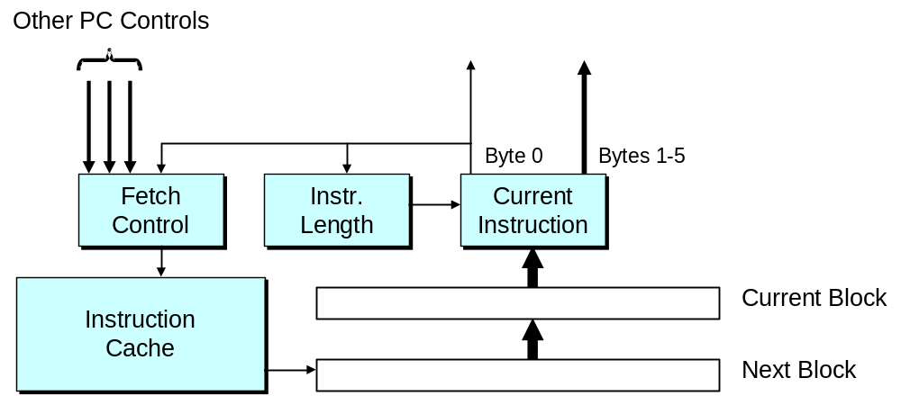
More Realistic Fetch Logic
Fetch Box
  Integrated into instruction cache
  Fetches entire cache block (16 or 32 bytes)
  Selects current instruction from current block
  Works ahead to fetch next block
    As reaches end of current block
    At branch target

Slide 47
Next
Machine-Independent Optimization
  Code motion
  Memory optimization
Suggested reading
  5.1 ~ 5.6

